Slide 1

Deep-AmPEP30: Improve Short Antimicrobial Peptides Prediction with Deep Learning
Jielu Yan, Pratiti Bhadra, Ang Li, Pooja Sethiya, Longguang Qin, Hio Kuan Tai, Koon Ho Wong, Shirley W.I. Siu
Molecular Therapy - Nucleic Acids
Volume 20 Pages 882-894 (June 2020)
DOI: 10.1016/j.omtn.2020.05.006
Copyright © 2020 The Authors Terms and Conditions

Slide 2
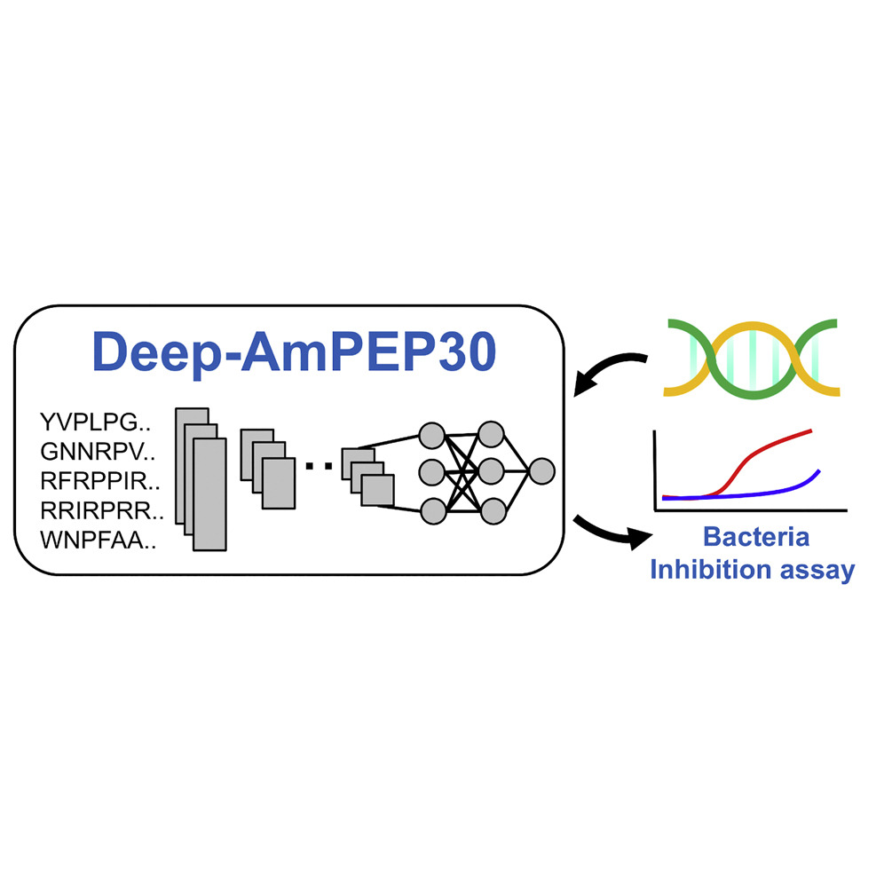
Molecular Therapy - Nucleic Acids 2020 20882-894DOI: (10.1016/j.omtn.2020.05.006)
Copyright © 2020 The Authors Terms and Conditions

Slide 3
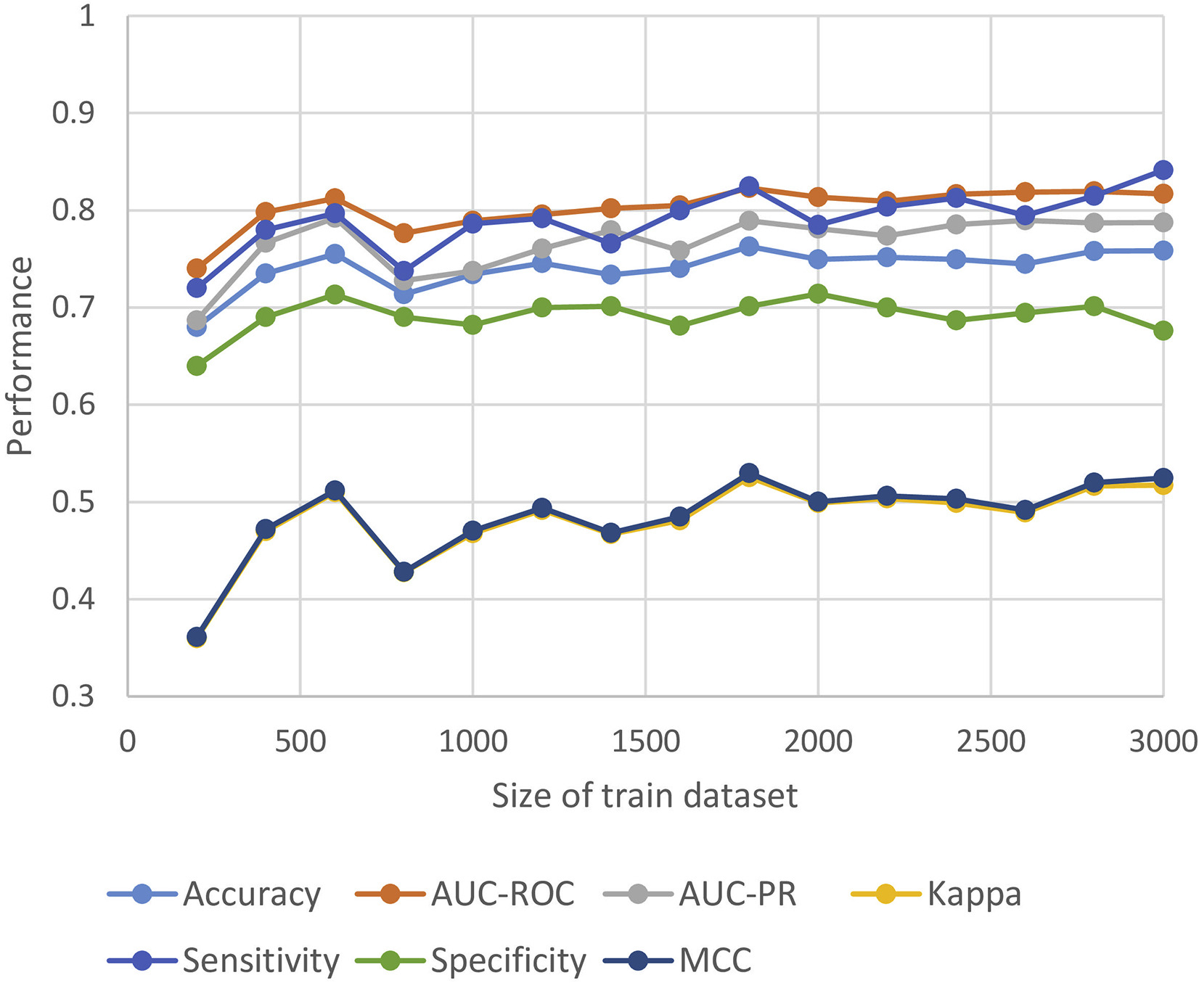
Figure 1
Molecular Therapy - Nucleic Acids 2020 20882-894DOI: (10.1016/j.omtn.2020.05.006)
Copyright © 2020 The Authors Terms and Conditions
Notes:
Size Effect of the Train Dataset on Model Performance

Slide 4
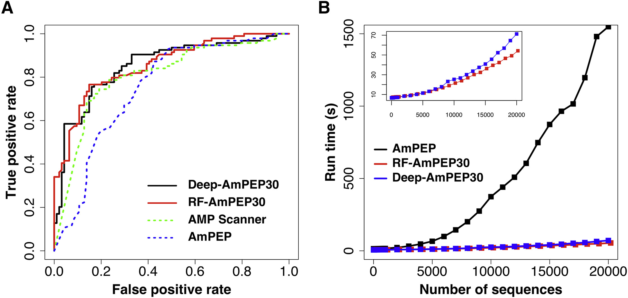
Figure 2
Molecular Therapy - Nucleic Acids 2020 20882-894DOI: (10.1016/j.omtn.2020.05.006)
Copyright © 2020 The Authors Terms and Conditions
Notes:
Performance of AMP Classifiers
(A) Receiver operator characteristic curves of different AMP classifiers and (B) their run time performances on the benchmark dataset.

Slide 5
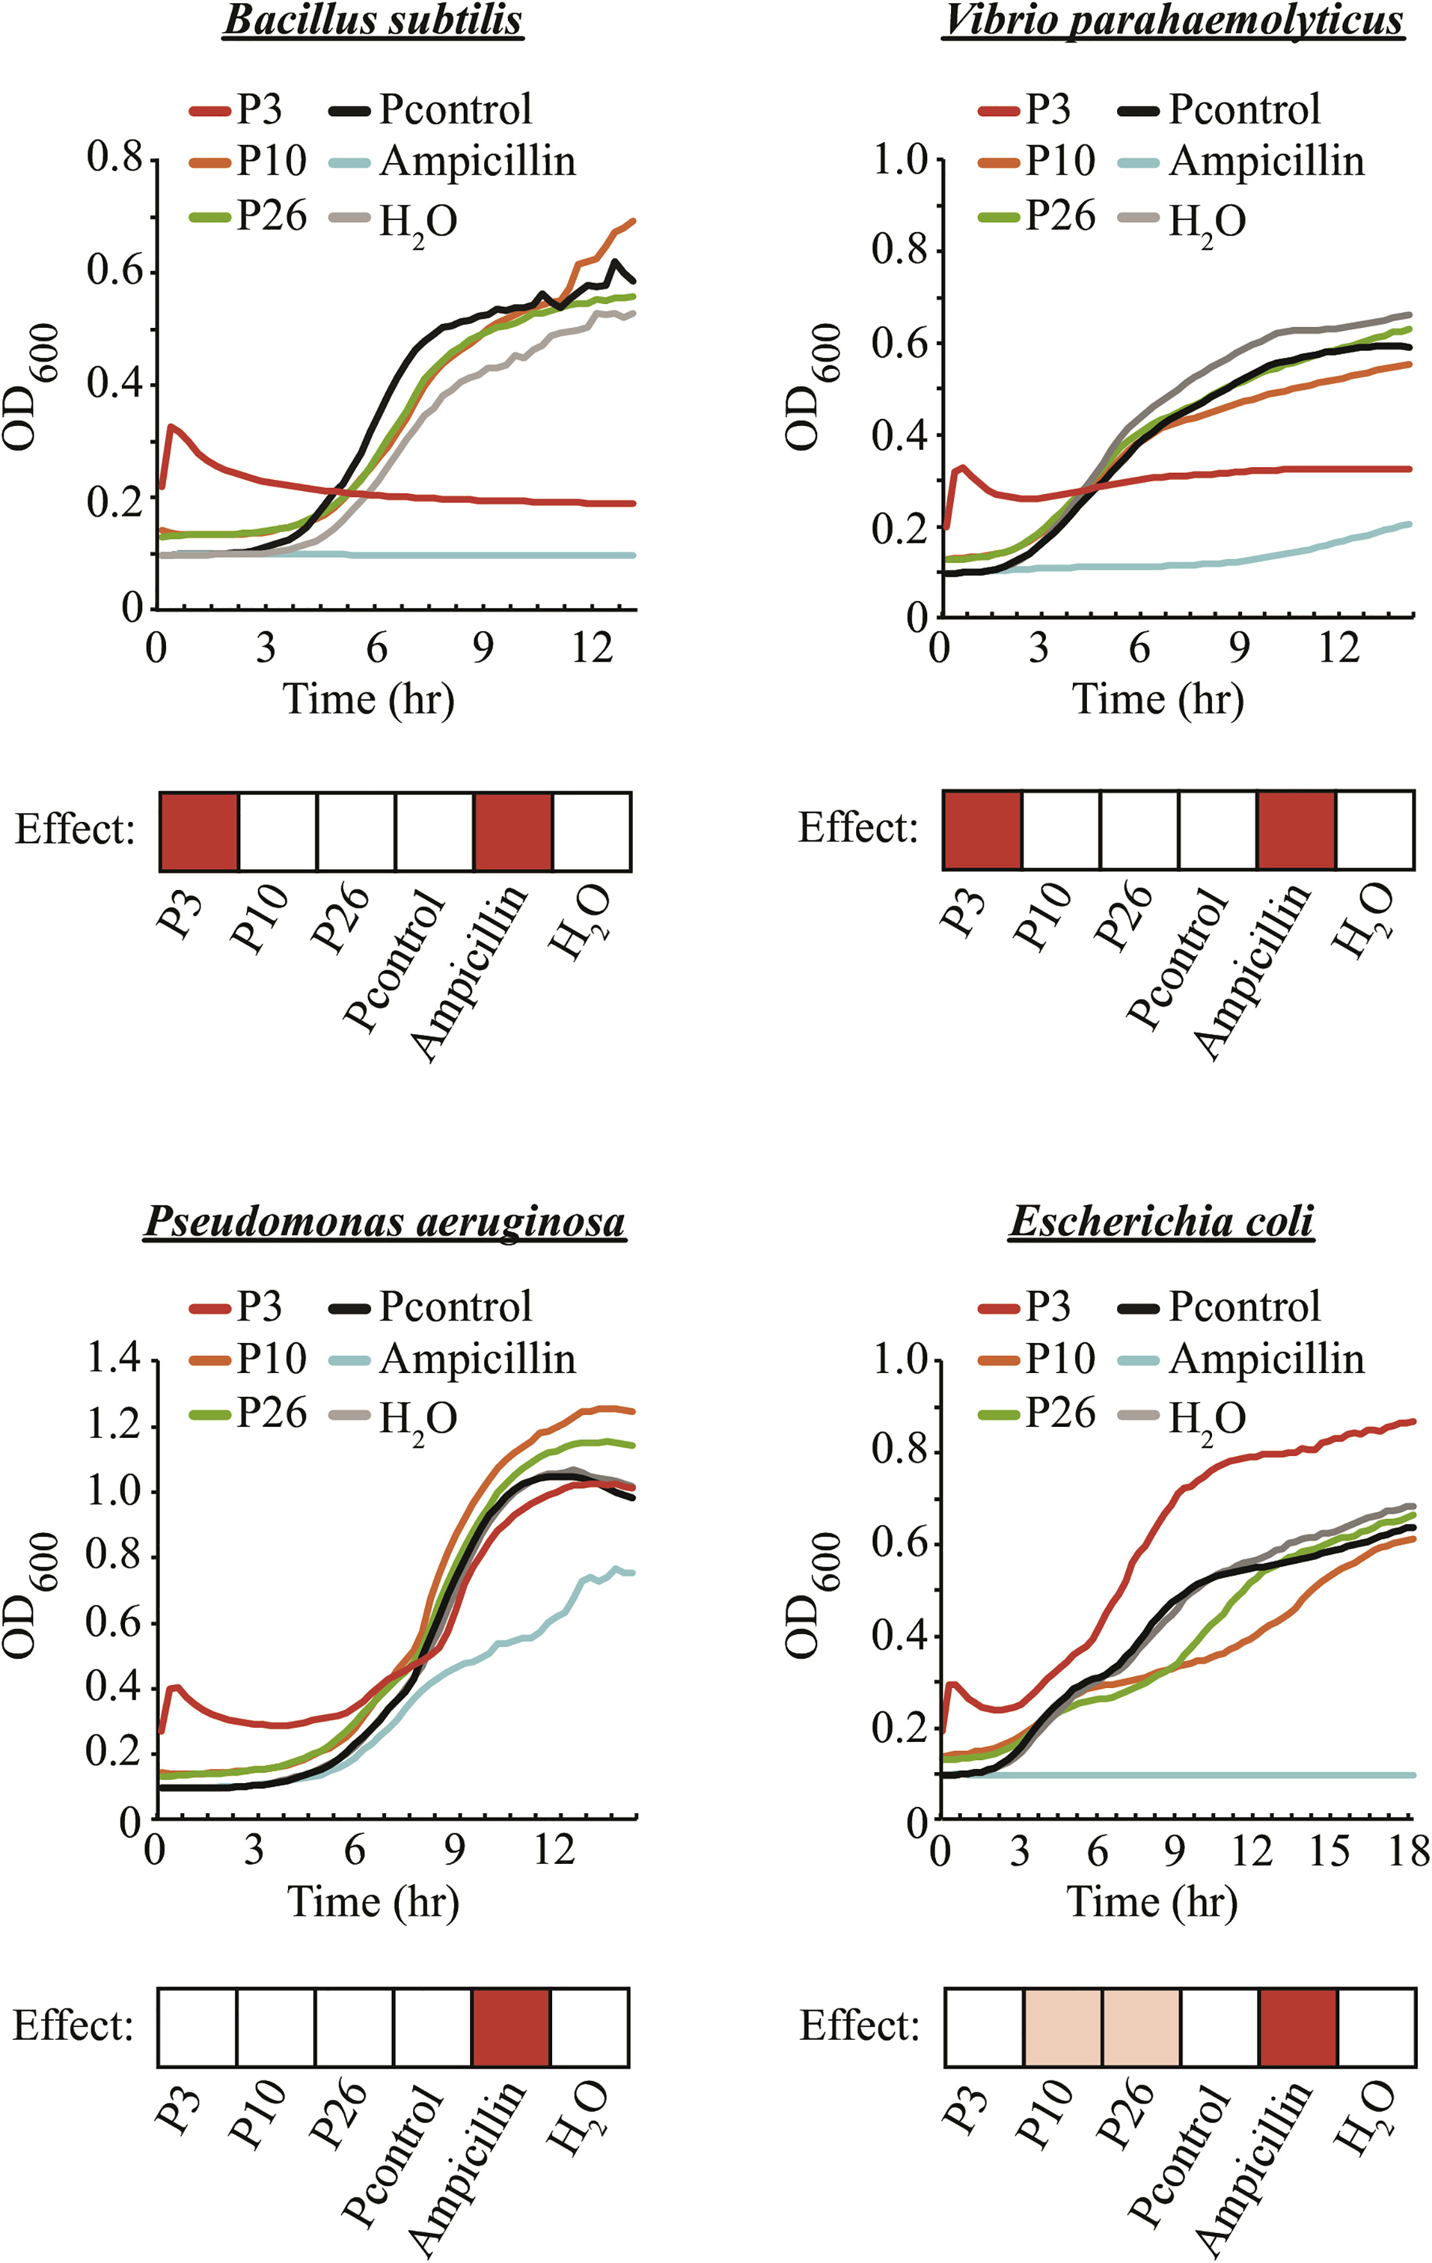
Figure 3
Molecular Therapy - Nucleic Acids 2020 20882-894DOI: (10.1016/j.omtn.2020.05.006)
Copyright © 2020 The Authors Terms and Conditions
Notes:
Anti-Bacterial Effect of Three Top-Ranked Predicted AMPs against Four Different Bacteria Species
Growth assay of Bacillus subtilis, Vibrio parahaemolyticus, Pseudomonas aeruginosa, and Escherichia coli in the absence (H2O) or presence of P3, P10, P26, and a control peptide (Pcontrol) that is known to have no anti-bacterial effect. Ampicillin was used as a positive control. Growth of bacteria was measured by absorbance at OD600 over time. The average of three independent experiments is presented. Treatment showing an inhibitory effect against the assayed bacteria is highlighted by a red box. A pink box indicates a subtle but significant (e.g., consistent in all three biological repeats) effect.

Slide 6
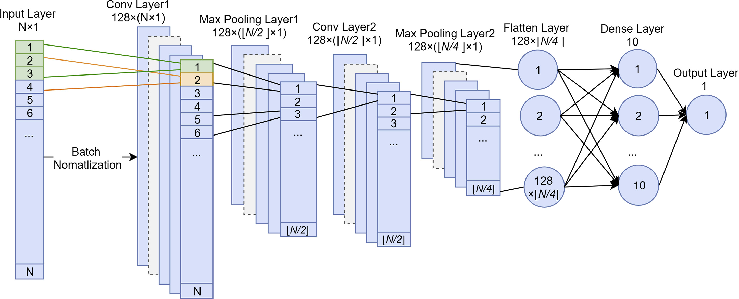
Figure 4
Molecular Therapy - Nucleic Acids 2020 20882-894DOI: (10.1016/j.omtn.2020.05.006)
Copyright © 2020 The Authors Terms and Conditions
Notes:
The Architecture of Our CNN-Based Classifier for Short AMP Prediction
The model accepts a feature vector of N elements as input. First, the data values are normalized using a batch size of 64; then, the input is transferred into convoluted features by two convolutional layers and two maximum pooling layers. Each convolutional layer applies 128 kernels using a kernel size of 3 × 1 with stride 1, while each maximum pooling layer pools together data using a kernel size of 2 × 1 with stride 2. A dropout rate of 20% is applied in the maximum pooling step to prevent overfitting. Finally, all convoluted features are flattened and fed into a fully connected neural network with 10 hidden nodes and 1 output node. The rectified linear function (ReLU) is used as the activation function in the convolutional layer and by the hidden nodes, but the sigmoid function is used by the output node.

